Slide 1







LOYO EVENTS
By,
AFZAL K S L,
23021U09002,
Guide: Prof. DHARMARAJ S, MCA., MBA., M.Phil., Ph.D.,

Slide 2
ABSTRACT
LOYO EVENTS is a transformative platform designed to bring the beauty to the college life, creating a vibrant ecosystem for providing information to all the students. Serving as a digital media, Loyo Events empowers the students to acknowledge about the events and register in a simple way. Loyo Events can lead to error free, secure, reliable, and fast registration. By leveraging the power of technology and community, Loyo Events can assist the admin to concentrate on their other activities rather to concentrate on the record keeping.
The purpose of Loyo Events is to automate the existing manual system by the help of computerized equipment and full-fledged computer software fulfilling their requirements, so that their valuable data/information can be stored for longer period with easy accessing and manipulation of the same.

Slide 3



TABLE OF CONTENTS
01
02
EXISTING SYSTEM VS PROPOSED SYSTEM
LIST OF MODULES
03
04
DATABASE DIAGRAMS
OUTPUT SCREEN

Slide 4



01
EXISTING SYSTEM VS PROPOSED SYSTEM

Slide 5
EXISTING SYSTEM
The existing system relies heavily on manual processes such as paper-based registrations, excel spreadsheets for scheduling, and email communication for coordination. Information and resources are scattered across various platforms and documents, making it challenging to maintain consistency and transparency. Participants may face difficulties accessing event information or registering due to limited online presence or outdated systems. Without a dedicated system, there's a lack of efficient resource allocation and utilization, leading to potential wastage and inefficiencies

Slide 6
PROPOSED SYSTEM
Loyo Events automates many tasks such as registration, scheduling, and communication, reducing manual effort and saving time for organizers and participants. It provides a centralized platform where all event-related information, including schedules, registrations, and resources, is stored and accessible to authorized users. It offers a user-friendly web interface accessible from any device with an internet connection, enabling seamless access to event information and registration.

Slide 7
SOFTWARE REQUIREMENTS
HARDWARE REQUIREMENTS
Operating System : Windows 7 and Above
Front-End : HTML, CSS, JavaScript
Backend-End : PHP, MySQL
Software : XAMPP, VS Code
Server : Apache
Processor : Intel Core i3
Hard Disk : 256 GB
RAM : 4GB

Slide 8


02
LIST OF MODULES

Slide 9
1. Register
Module for Participants to Register the Events.
2. Login
Module for Participants to check that the Events are successfully registered.
3. About Us
Module used to display current winners.
4. Event
Module used to create and delete the Events.
5. Staff Co-ordinator
Module used to update the Staff Co-Ordinator.
6. Student Co-ordinator
Module used to update the Student Co-ordinator.

Slide 10



03
DATABASE DIAGRAMS

Slide 11
USE CASE(USER)
PARTICIPANTS VIEW

Slide 12
USE CASE(ADMIN)
ADMIN
VIEW

Slide 13
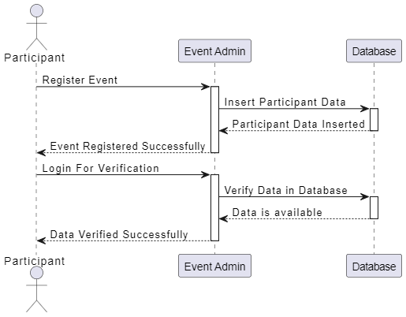
SEQUENCE DIAGRAM

Slide 14
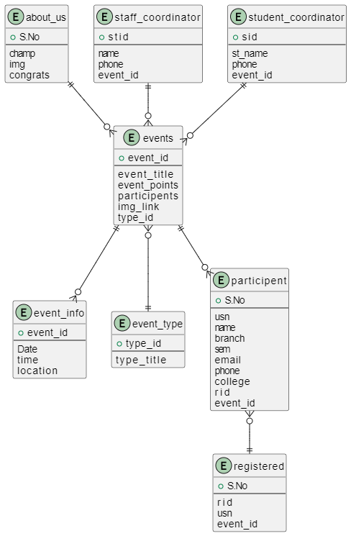
DATA FLOW DIAGRAM

Slide 15
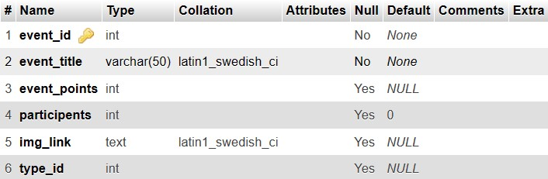
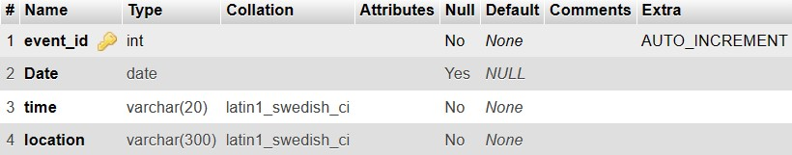
DATABASE DIAGRAM
This table is used to display the details of the Events.
This table is used to display the details of the Event Informations.

Slide 16
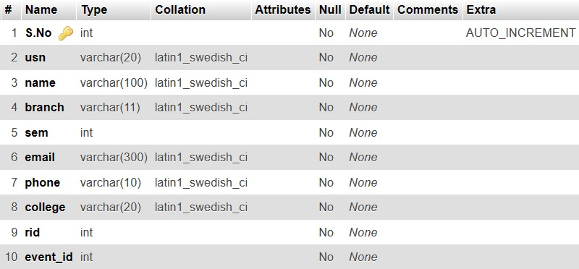
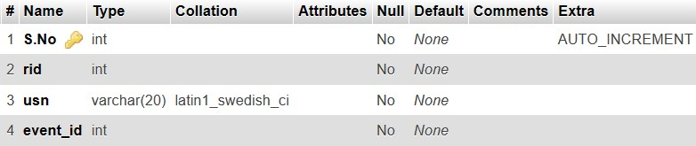
This table is used to stores the details of the Participants.
This table is used to retrieve and check the Participants are already registered.

Slide 17
OUTPUT SCREEN
04

Slide 18
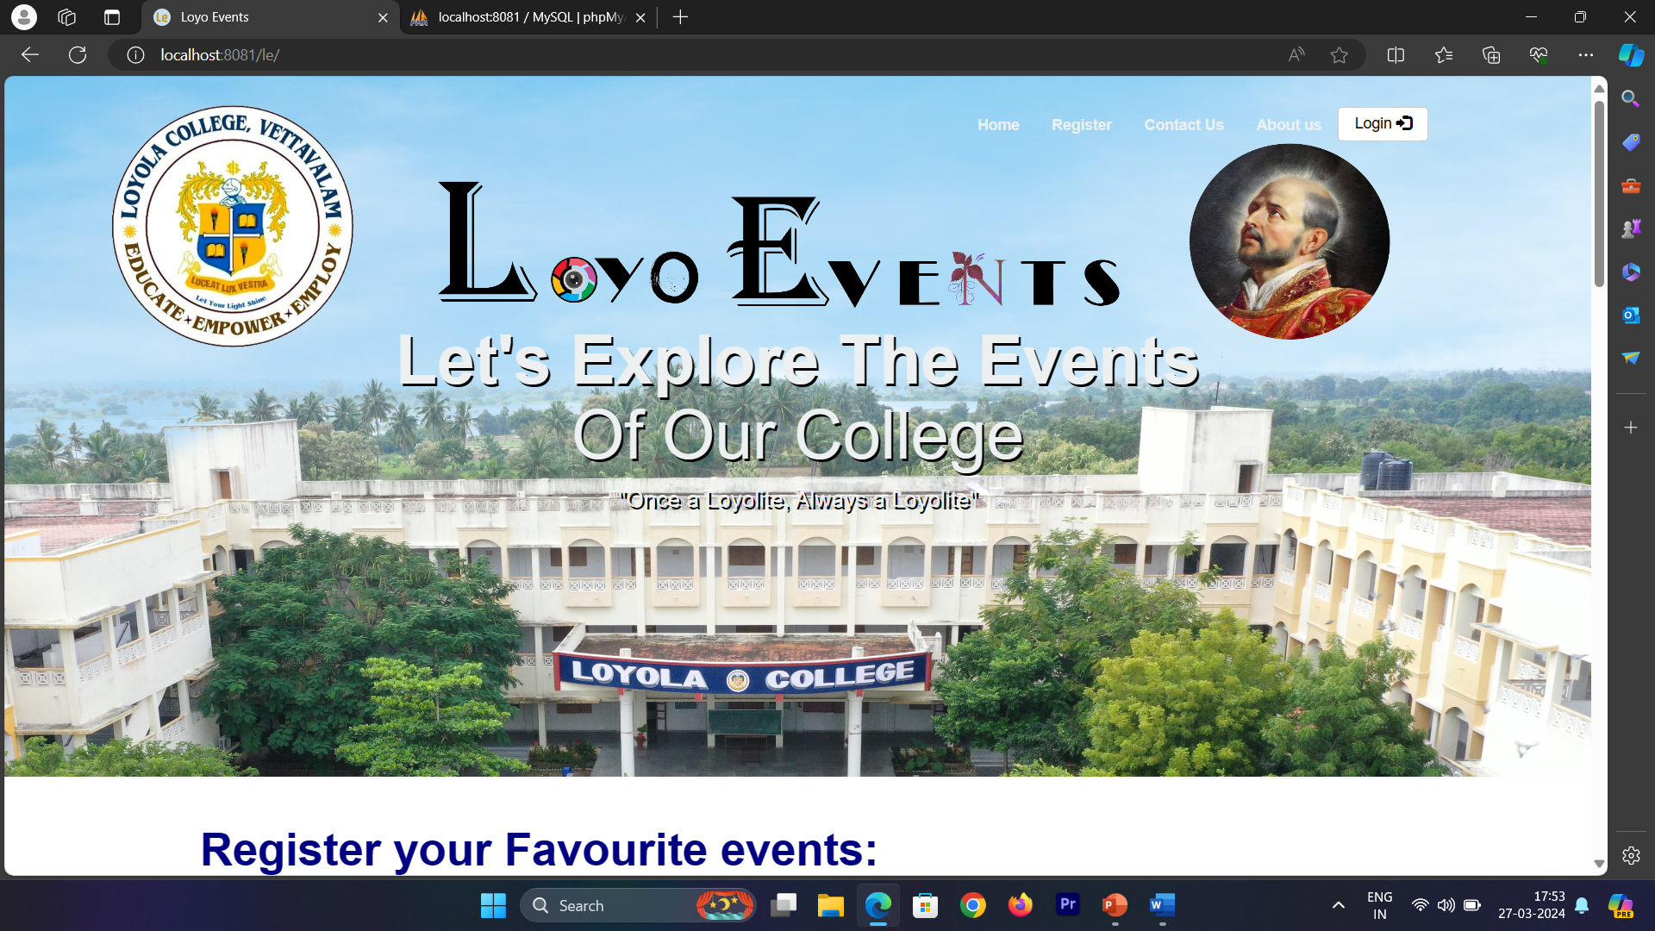
HOME PAGE

Slide 19
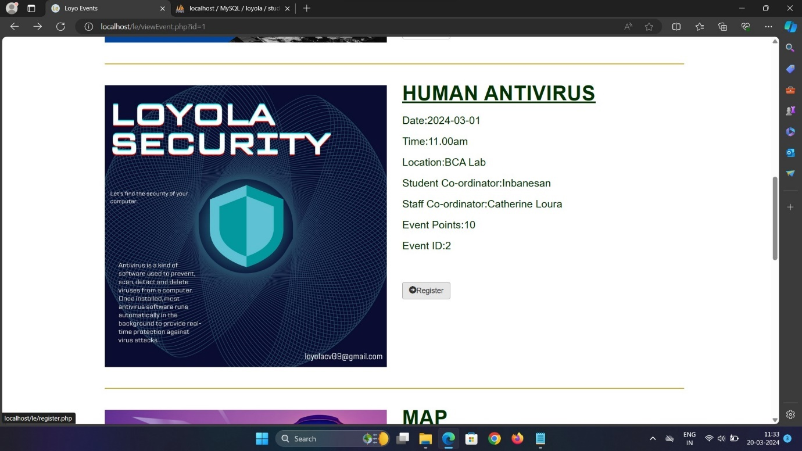
DISPLAY UPCOMING EVENTS

Slide 20
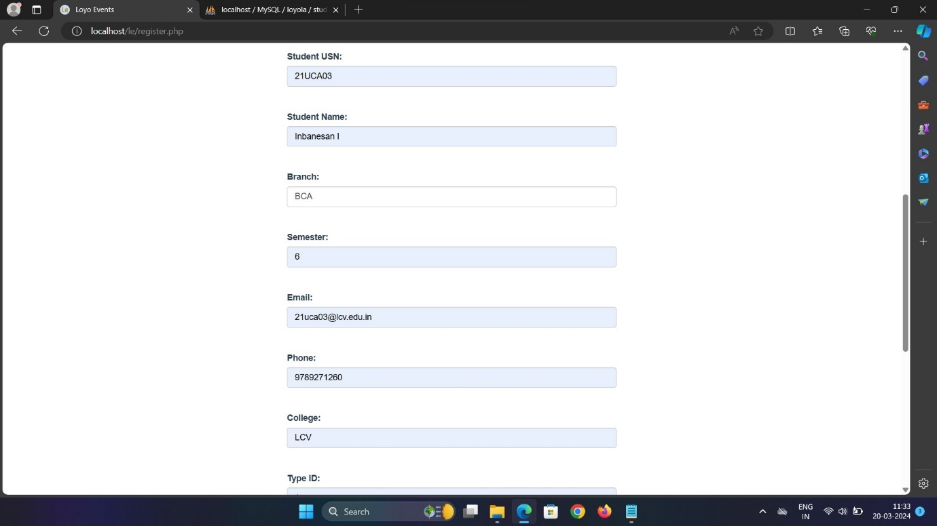
REGISTER TO THE EVENTS

Slide 21
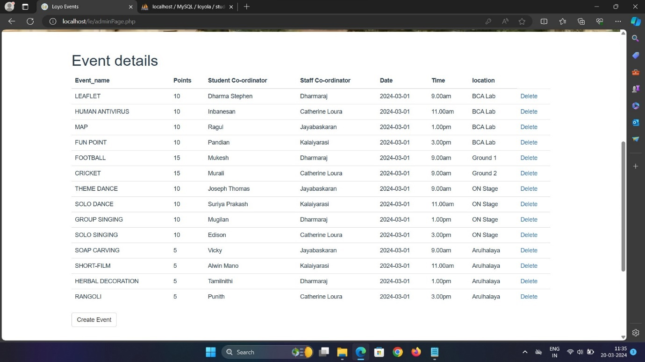
TOTAL EVENTS

Slide 22


CONCLUSION
Loyo Events provides a way to share the knowledge about the events to everyone at a same time, which gives an ethics and avoids partiality to any individual person.
It is helpful to the participants to register from anywhere.
So, let make good use of this web application to showcase your talents.

Slide 23
FUTURE WORKS
ACCESS CONTROL:
The Department staff are only allowed to register via this web application for some sort of events.
PAYMENT INTEGRATION:
Events like Webinar and Symposium are added with payment integration.

Slide 24
THANK YOU

